Slide 1
Have Fun with Math Centers for a Day of Review in the 3rd Grade
By Heather Herrig

Slide 2
Grade Level and Time
Each of the five math centers are meant to be review centers for 3rd grade students. They should each take about 15-20 minutes, but time also depends on the students. It may take some students a shorter length of time and some a longer length of time to think about the work they are doing.

Slide 3
Objectives
*The student will be able to multiply fluently within 100.
*The student will be able to know products of two one-digit numbers from memory.
*The student will be able to round to the nearest 10 or 100.
*The student will be able to find perimeters and areas of polygons.
*The student will be able to measure to the nearest centimeter.

Slide 4
Prerequisites
The student should already have knowledge of…
…multiplication facts.
…rounding to the nearest 10 and 100.
…finding the perimeter of polygon.
…finding the area of a rectangle.
…measuring to the nearest centimeter.

Slide 5
ON TO THE STATIONS…!

Slide 6
Computer Station
With this station students can use technology and playing games to review multiplication facts. Your students can have a little fun playing multiplication games online at:
http://www.math-play.com/3rd-grade-math-games.html
Common Core Math Standard addressed:
CCSS.Math.Content.3.OA.C.7 Fluently multiply and divide within 100, using strategies such as the relationship between multiplication and division (e.g., knowing that 8x5=40, one knows 40/5=8) or properties of operations. By the end of Grade 3, know from memory all products of two one-digit numbers.

Slide 7
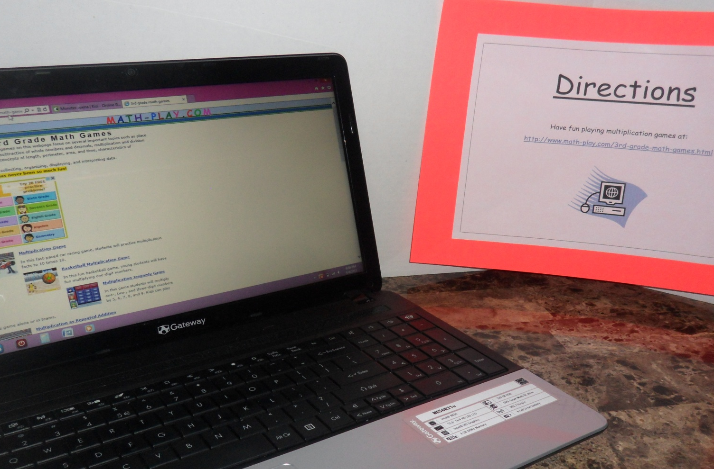
Computer Station

Slide 8
Place Value/Rounding Station
With this station students can have a little fun adding on a calculator and then rounding the answer to the nearest 10 or the nearest 100. Students will need a calculator, a pencil, and an "Addition with a Calculator and Rounding Fun" worksheet to complete this center.
Common Core Math Standard addressed:
CCSS.Math.Content.3.NBT.A.1 Use place value understanding to round whole numbers to the nearest 10 or 100.

Slide 9
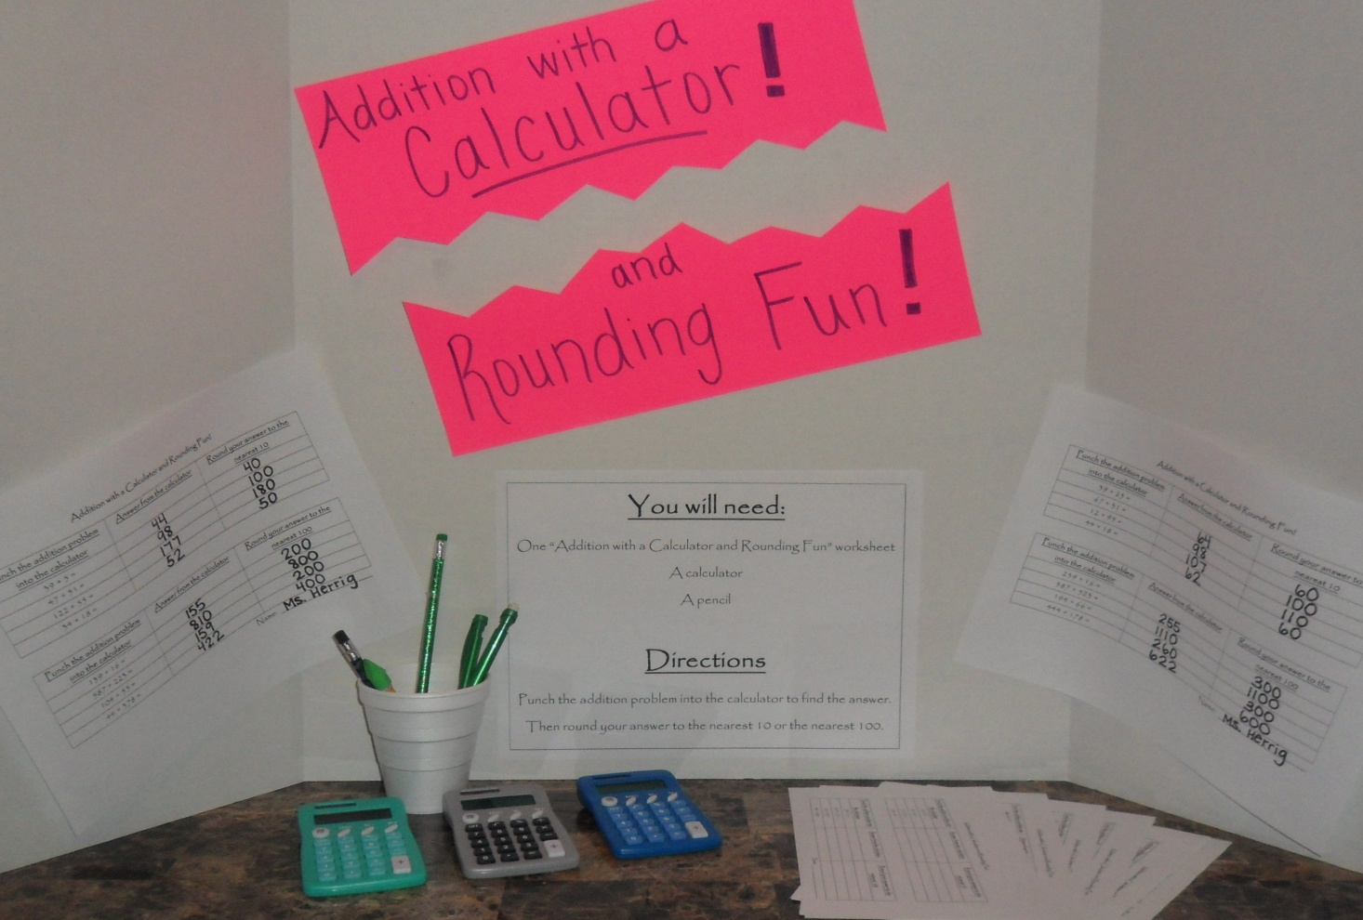
Place Value/Rounding Station

Slide 10
Array Station
With this station students can have some fun using stickers to make as many arrays as they can for the number they draw from the cup. The student should draw a popsicle stick with a number on it from the cup. They should write their number at the top of the paper and use the stickers to make all the arrays they can for that number. Each array should be labeled.
Common Core Math Standard addressed:
CCSS.Math.Content.3.OA.A.1 Interpret products of whole numbers, e.g., interpret 5x7 as the total number of objects in 5 groups of 7 objects each. For example, describe a context in which a total number of objects can be expressed as 5x7.

Slide 11
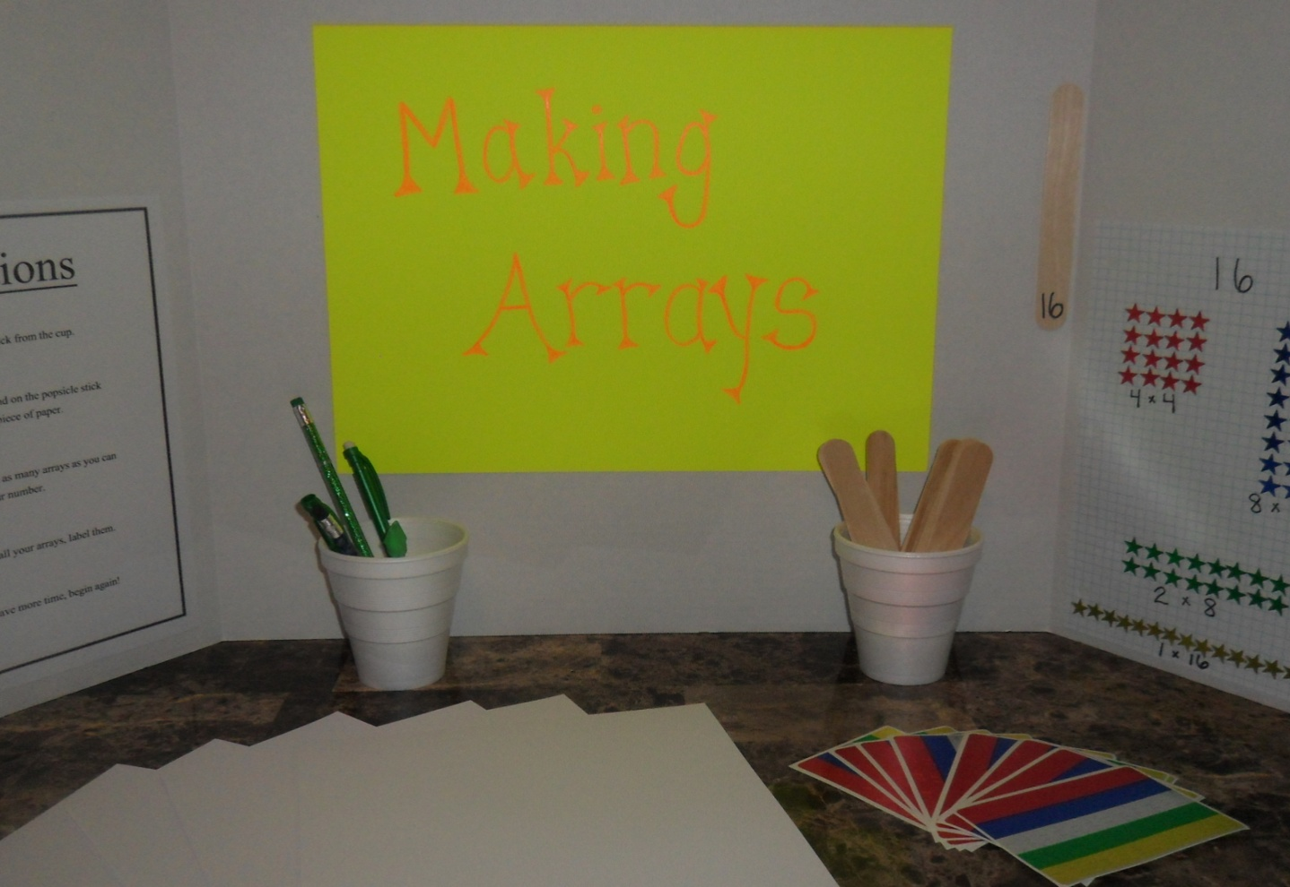
Array Station

Slide 12
Polygon/Measuring Station
With this station students should follow the directions for some fun with polygons! They will need a pencil, a ruler, scissors, a glue stick, one small piece of colored construction paper, and a "Fun with Polygons" worksheet. They will need to find perimeters and areas of polygons as well as unknown lengths to certain sides of polygons. They will also get to cut and paste their own polygon and measure it to find it's perimeter.
Common Core Math Standard addressed:
CCSS.Math.Content.3.MD.D.8 Solve real world and mathematical problems involving perimeters of polygons, including finding the perimeter given the side lengths, finding an unknown side length, and exhibiting rectangles with the same perimeter and different areas or with the same area and different perimeters.

Slide 13
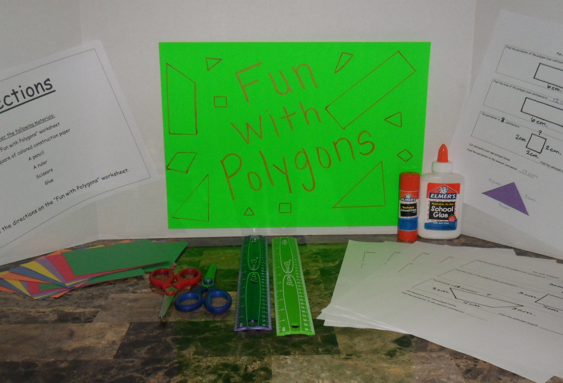
Polygon/Measuring Station

Slide 14
Flashcard Station
At the flashcard station students can have a little fun with a partner and some multiplication flashcards! The students should see how quickly they can answer the multiplication problems as their partner flashes the multiplication flashcard. Encourage your students to try to get quicker each time they answer!
Common Core Math Standard addressed:
CCSS.Math.Content.3.OA.C.7 Fluently multiply and divide within 100, using strategies such as the relationship between multiplication and division (e.g., knowing that 8x5=40, one knows 40/5=8) or properties of operations. By the end of Grade 3, know from memory all products of two one-digit numbers.

Slide 15
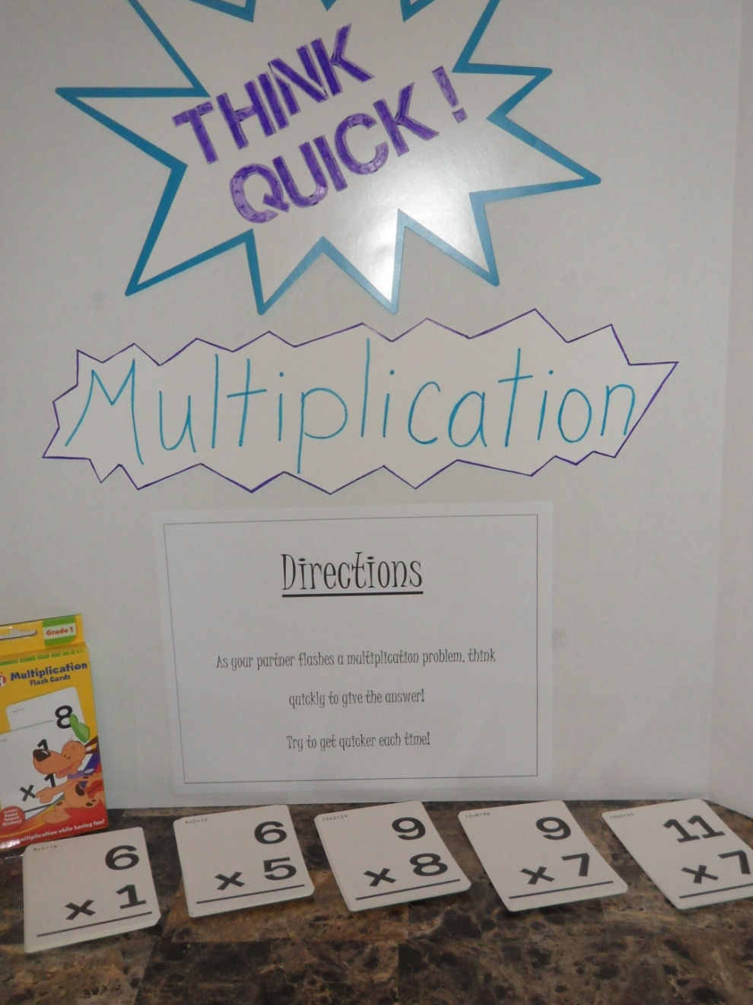
Flashcard Station

Slide 16
My Reflection
I had a great time putting these centers together, but found out that it takes a lot of time to set such centers up. I also decided that not everything has to be “top-notch” and expensive to make learning fun. My own kids were very interested in these math centers as I was putting them together and actually wanted to experience them for themselves! I hope that is a good clue that students in an actual classroom would have fun with them as well! Centers such as these can be very useful for independent practice as well as guided practice as a teacher can walk around to each of the centers giving guidance and more one-on-one help if needed. Students can be assessed on these reviews by turning in the work they complete and also by the teacher observing how each students is doing at each center. I look forward to coming up with more center ideas throughout my educational journey and even throughout my career as a teacher!

